Slide 1
Making powerful science: an introduction to NGS data analysis
Dr Adam Cribbs
Group leader in systems biology
Botnar Research Centre

Slide 2
Purpose of this section
Introduction to the concepts in NGS data analysis
Data formats and quality control
Challenges in data analysis
Software and pipelines

Slide 3
Application of NGS sequencing
Whole genome sequencing
Genome re-sequencing
de novo genome sequencing
Metagenomics applications
Epigenetic profiling
Methylation sequencing
Nucleosome footprinting
Sequencing of
Genomic DNA
Targeted sequencing
PCR-amplified regions
Capture-enriched DNA
Genomic footprinting
ChIP sequencing
Sequencing of
DNA library
Transcriptome analysis
Novel RNA classes (lncRNAs)
Novel splice variants
RNA footprinting
Ribosomal footprinting
RNA-IP sequencing
Sequencing of
cDNA library
Transcriptome expression
mRNA
Small RNA

Slide 4

Bioinformatic challenges
Now I have my data what do I do????

Slide 5
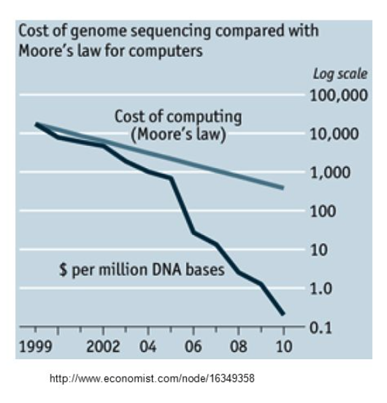
Bioinformatic challenges
2.7 billion to hundreds of £
NGS pushed the need for bioinformatics and big data analytics
Need for power!!

Slide 6
Need for computation
Need for computer power
VERY large files (10s of millions of lines)
Impossible to use familiar tools such as python
Impossible memory usage and execution time
Need for a large amount of compute power
Compute clusters
Parallel code and multi threading to speed up analysis
Need for faster software
Pipelines
Bioinformatics power!
Properly structured working

Slide 7
Data management issues
How to store data – very large raw data
Alternative data structures – e.g. binary storage (bam files)
Certain studies use different amounts of storage
RNA-seq per file 2Gb
WGS – 500 Gb files
Less of an issue now than it used to be 3-5 years ago – hardware improvements

Slide 8
Computational clusters
Multi-nodes (servers) with multi-cores
High performance storage (expensive)
In-line storage
Fast networks (50Gb Ethernet between nodes)
Located in a single data centre
Need skilled data-admin staff to monitor and fix issues

Slide 9
Cloud based analysis
Pros
Flexible
Pay for what you use
Don’t need to maintain a data centre
Cons
Transfer big data over internet is slow
You pay for bandwidth
Lower performance – disk IO
Privacy/data concerns
More expensive for long term projects

Slide 10
The future
NGS arrived in 2007/2008
No-one predicted NGS in 2001
How can we really predict the future?
Problems will always remain:
Software always lags behind hardware

Slide 11
Bioinformatics and computational biology
The term bioinformatician can mean many things
Usually little biology background but quantitative skills
Computational biologist is usually someone with a biology and quantitative background
There is definitely a massive skills shortage in both

Slide 12
How to learn computational skills
Introduction to Next-gen data analysis
EBI in Cambridge - https://www.ebi.ac.uk/training/online/course/functional-genomics-ii-common-technologies-and-data-analysis-methods/next-generation
OBDI program
3 month short term training for a particular skill
https://www.imm.ox.ac.uk/research/units-and-centres/mrc-wimm-centre-for-computational-biology/training
Undertake part of your PhD in a computational group

Slide 13
NGS analysis

Slide 14
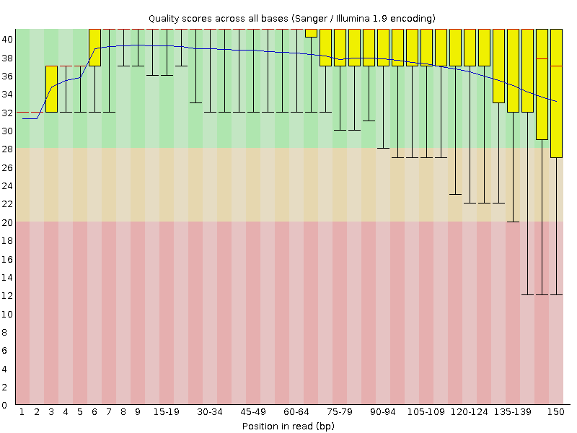
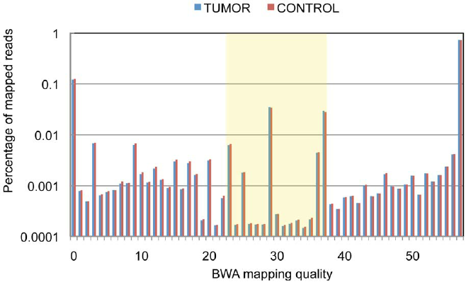
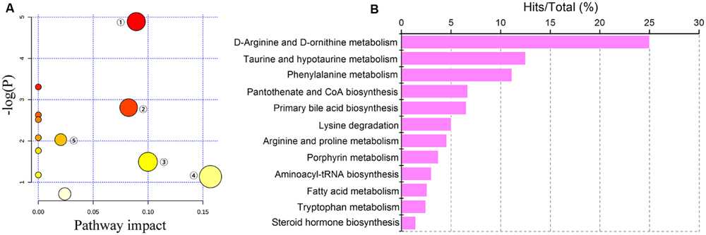
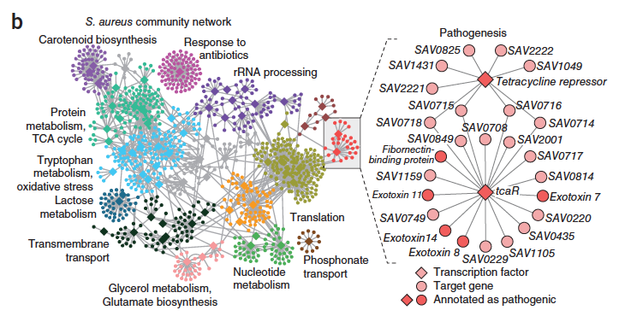
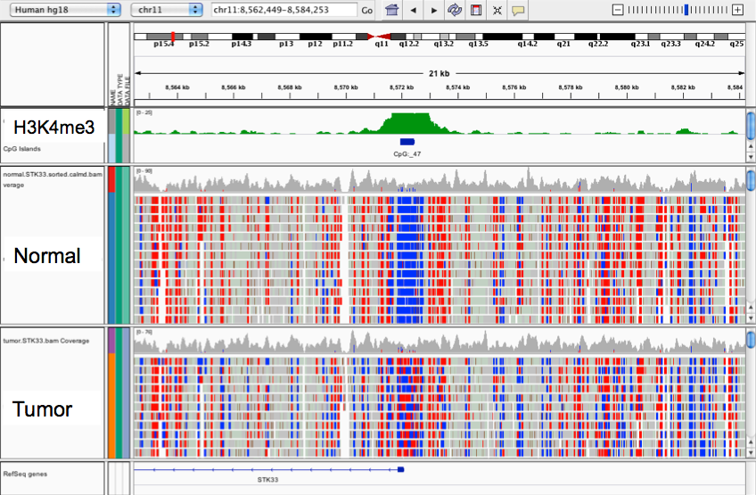
NGS data analysis
Raw reads from sequencer
Quality assessment of reads
Mapping
Pathway
analysis
Gene
networks
Data storage and visualisation

Slide 15
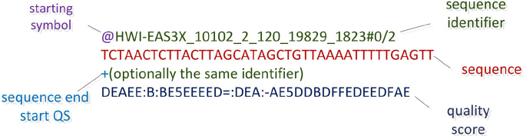
Quality control of reads
Sequencing output:
Reads + quality
Flat files – are very large – inefficient but it’s the standard
Question: is the quality of my sequencing data good?

Slide 16
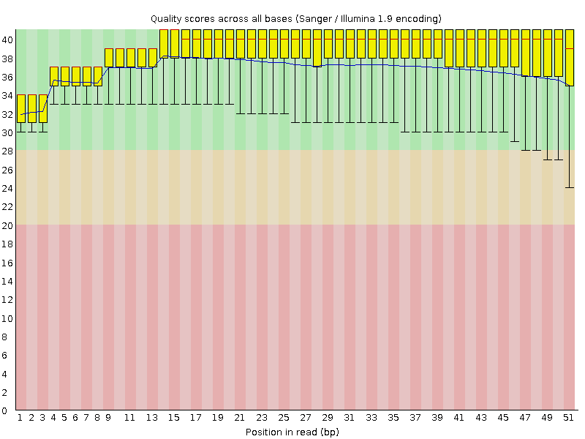
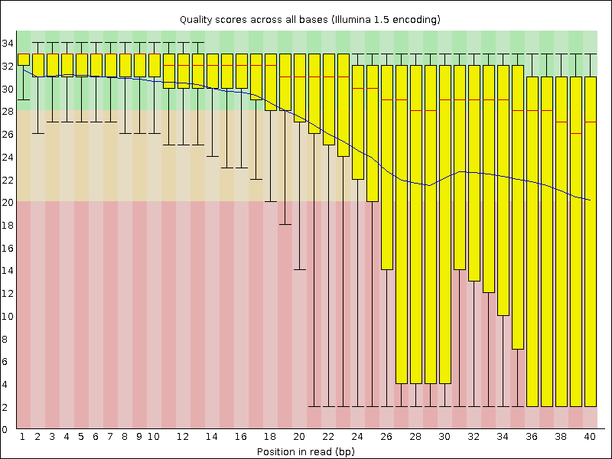
Quality control of reads
Fastqc – babraham institute
https://www.bioinformatics.babraham.ac.uk/projects/fastqc/

Slide 17
Tools to deal with read QC
Fastx-toolkit to optimize different datasets
Fastq-screen – check that all of your data is not contaminated
Trimming to improve quality
Trimmomatic
Cutadapt
There are many many more!
But beware of removing too many reads or trimming too much

Slide 18
Mapping reads to genome/transcriptome
Mapping data is very important to get correct
Many different mappers – make sure you use the latest software
Always treat your samples consistently

Slide 19
Mapping reads to genome/transcriptome
Main issues:
Number of mismatches
Number of multi-hits
Mates expected distance
Exon junction

Slide 20
GTF file for mapping
File format for reference sequence

Slide 21
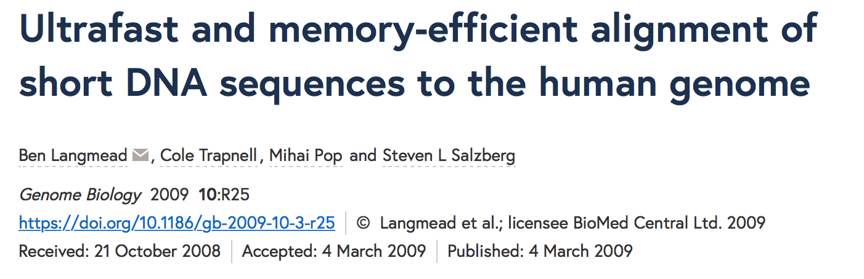
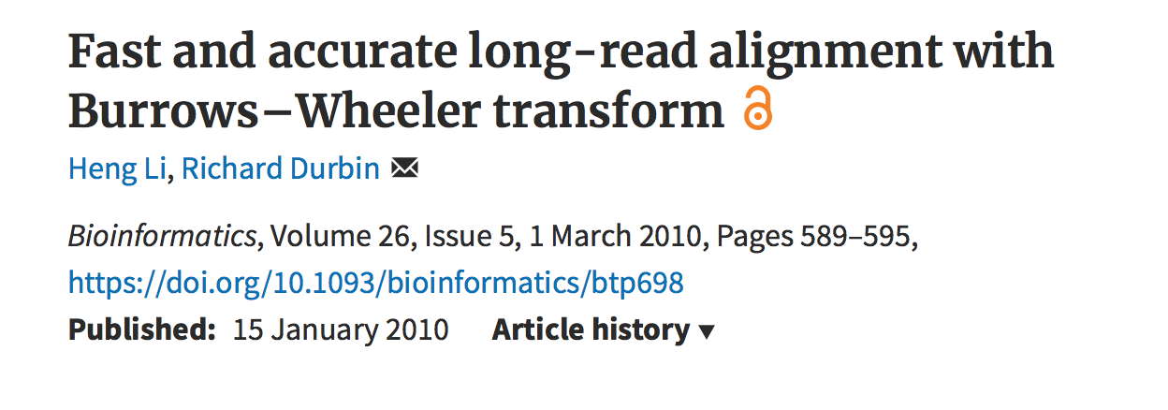
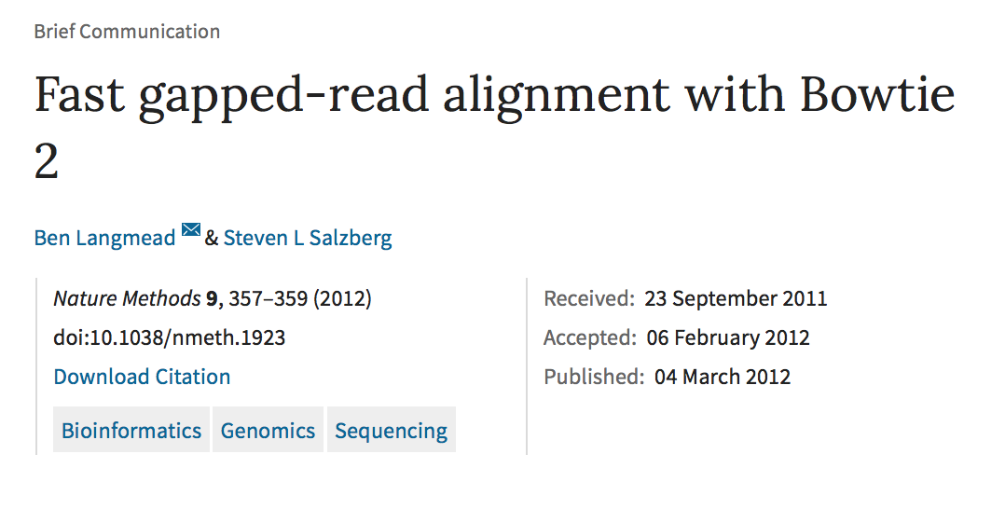
Mapping reads to genome
Which one to use???
Depends on application

Slide 22
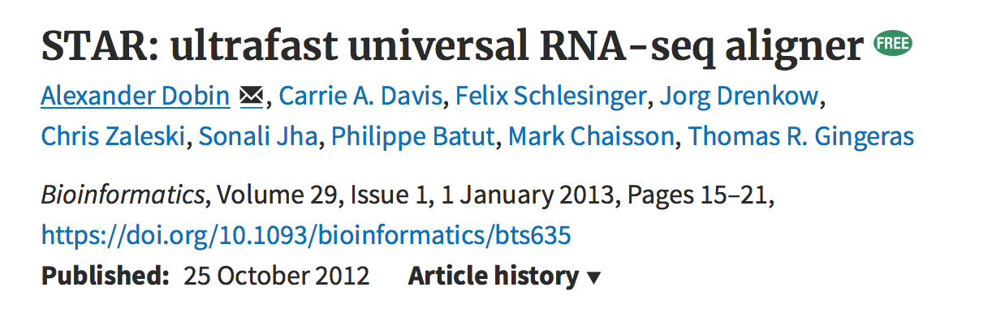
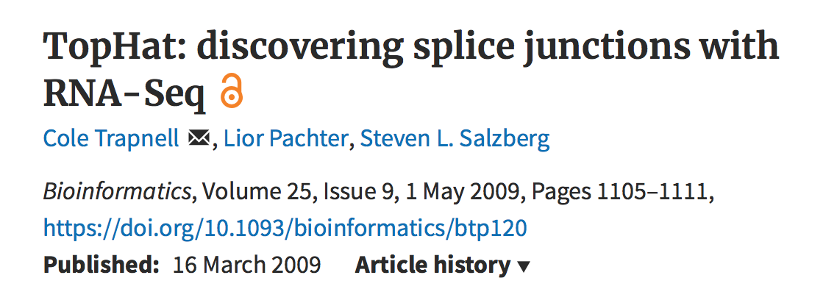
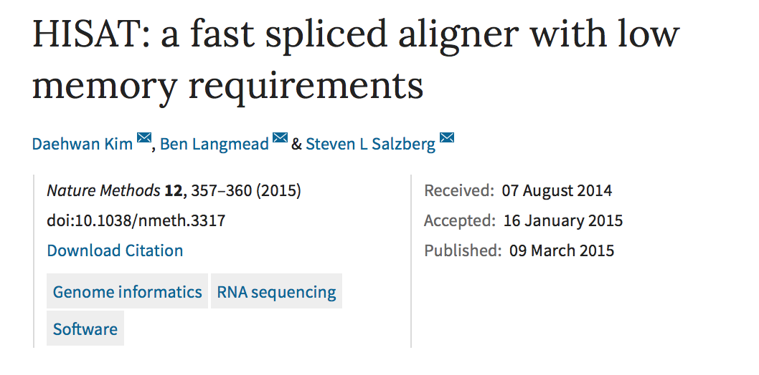
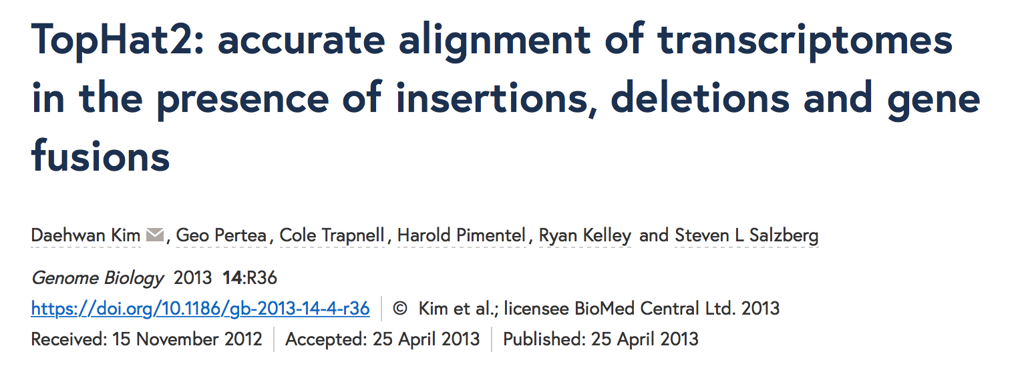
Mapping reads to transcriptome
Which one to use???
Depends on application
Don’t use tophat or hisat – use Tophat2 and hisat2

Slide 23
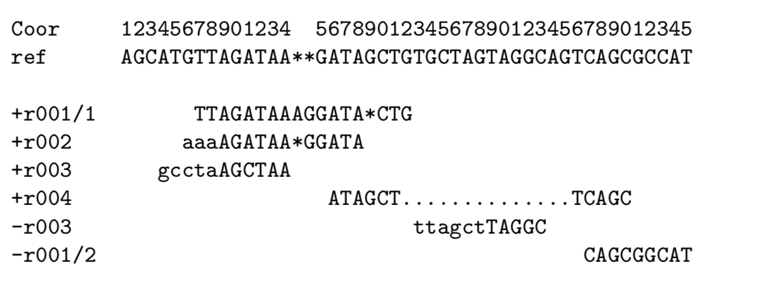
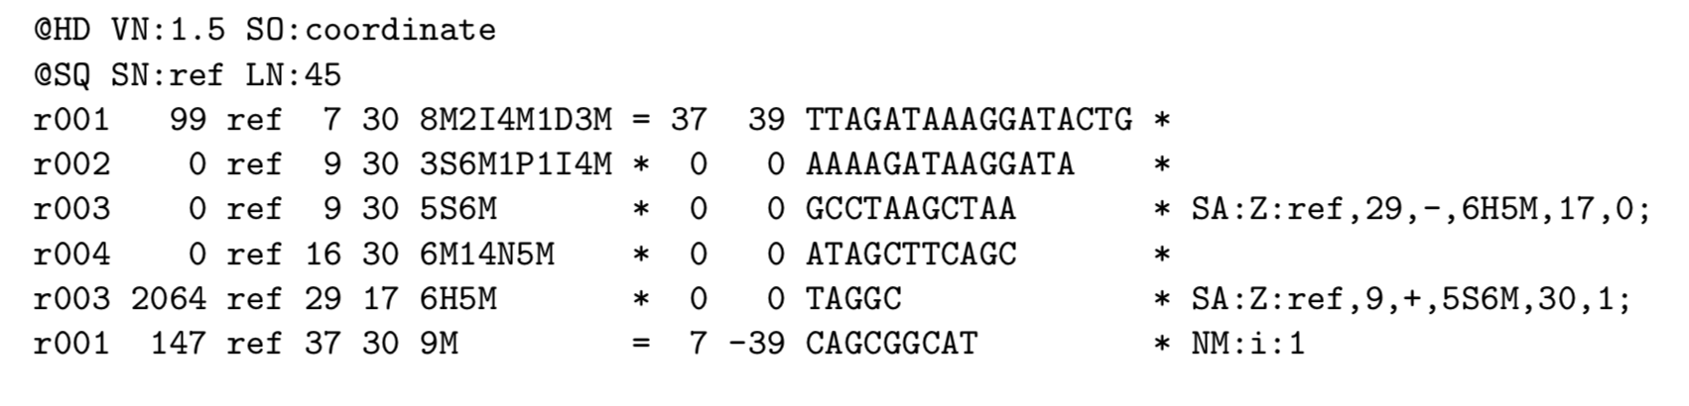
SAM/BAM format
Standard mapping output
Sequence alignment map (SAM)
Tab delimited
11 mandatory fields
1. Read name
10. Seq
2. Flag
4. Position
6. Cigar
8. Pos of mate
3. Reference
5. Quality
7. Ref name of mate
9. Template len

Slide 24
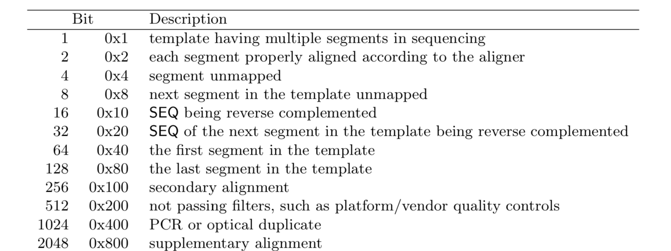
SAM/BAM format
FLAG
CIGAR

Slide 25
SAM/BAM tools
Commandline
Samtools
view
Index
Sort
Picard
MarkDuplicates
Python
Pysam – maintained and developed by CGAT (Andreas Hager)

Slide 26
Workflows: RNA-seq

Slide 27
RNA-seq workflow for DEG
Workflow1:
Tophat2 (align) -> cufflinks (transcript assembly) -> cuffdiff (DEG) -> cuffmerge (merge assemblies)
Workflow 2:
Hisat2 (align with any spliced mapper) -> featurecounts (counting reads to transcripts) -> DESeq2 or EdgeR (DEG)
Hisat2 alignment
featurecounts
DESeq2
General linear model that accounts for negative binomial distribution

Slide 28
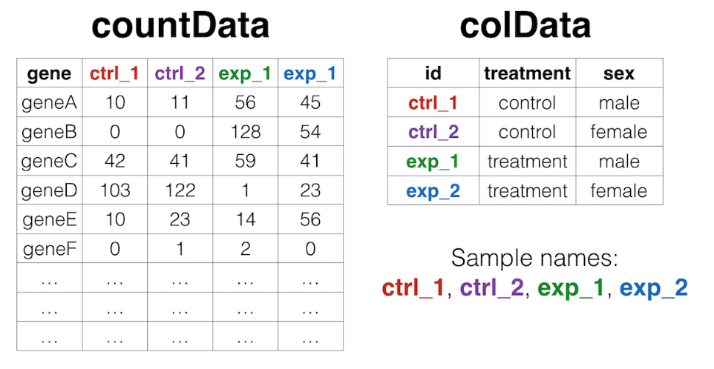
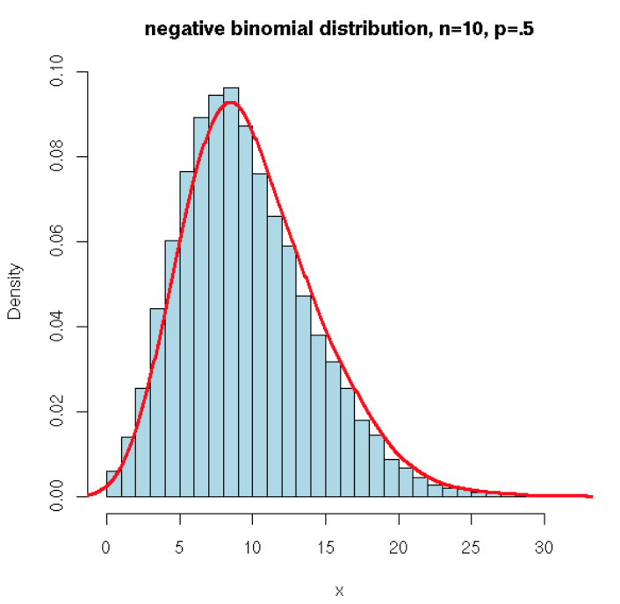
Count data
Following featurecounts you are left with a counts table
Fewer genes with large counts and more with fewer counts

Slide 29
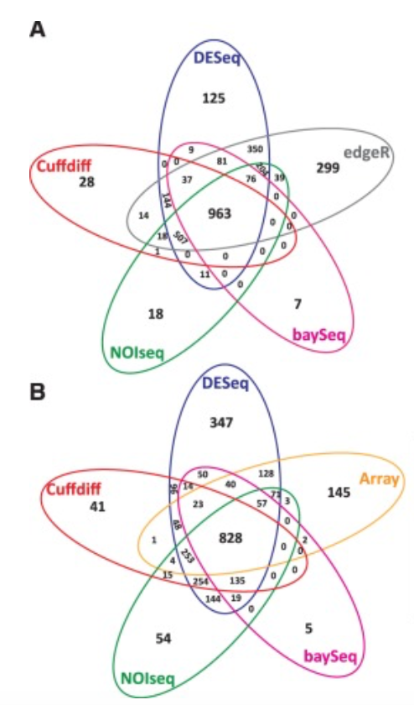
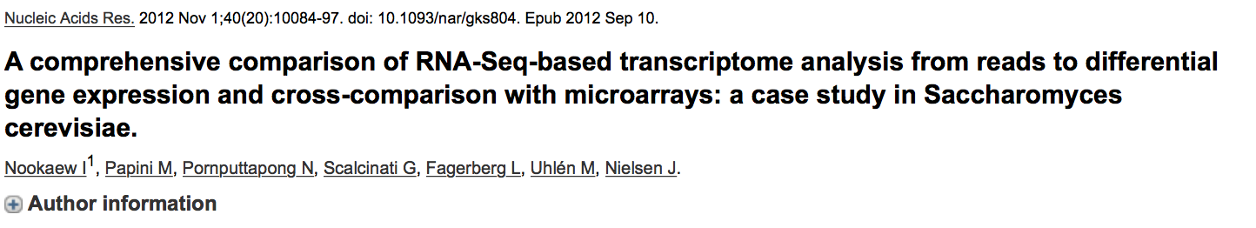
DEG methods compared
Which model to use????
My preference is DESeq2
Well written and better support
edgeR not accounting for typeI errors as well?
Microarray
RNA-seq

Slide 30
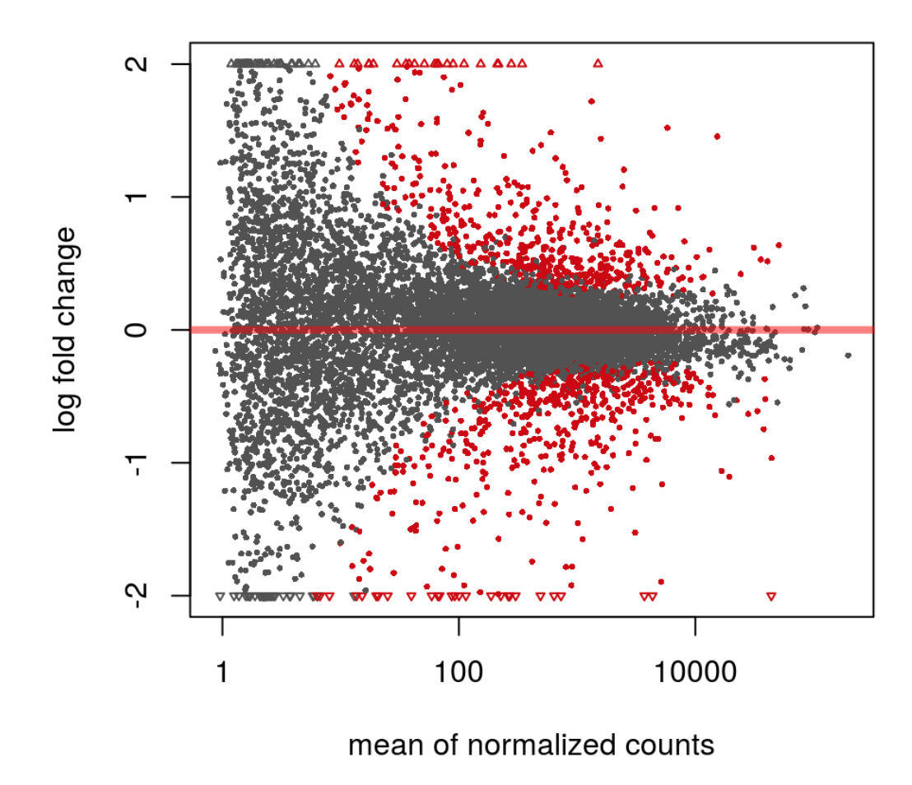
DESeq2 model
Model overview:
First fits a GLM to the data using a sample size factor
Cooks distance for counts outlier detection
Dispersion is measured
zero-centered normal prior to shrink lower end
Wald test or LRT test

Slide 31
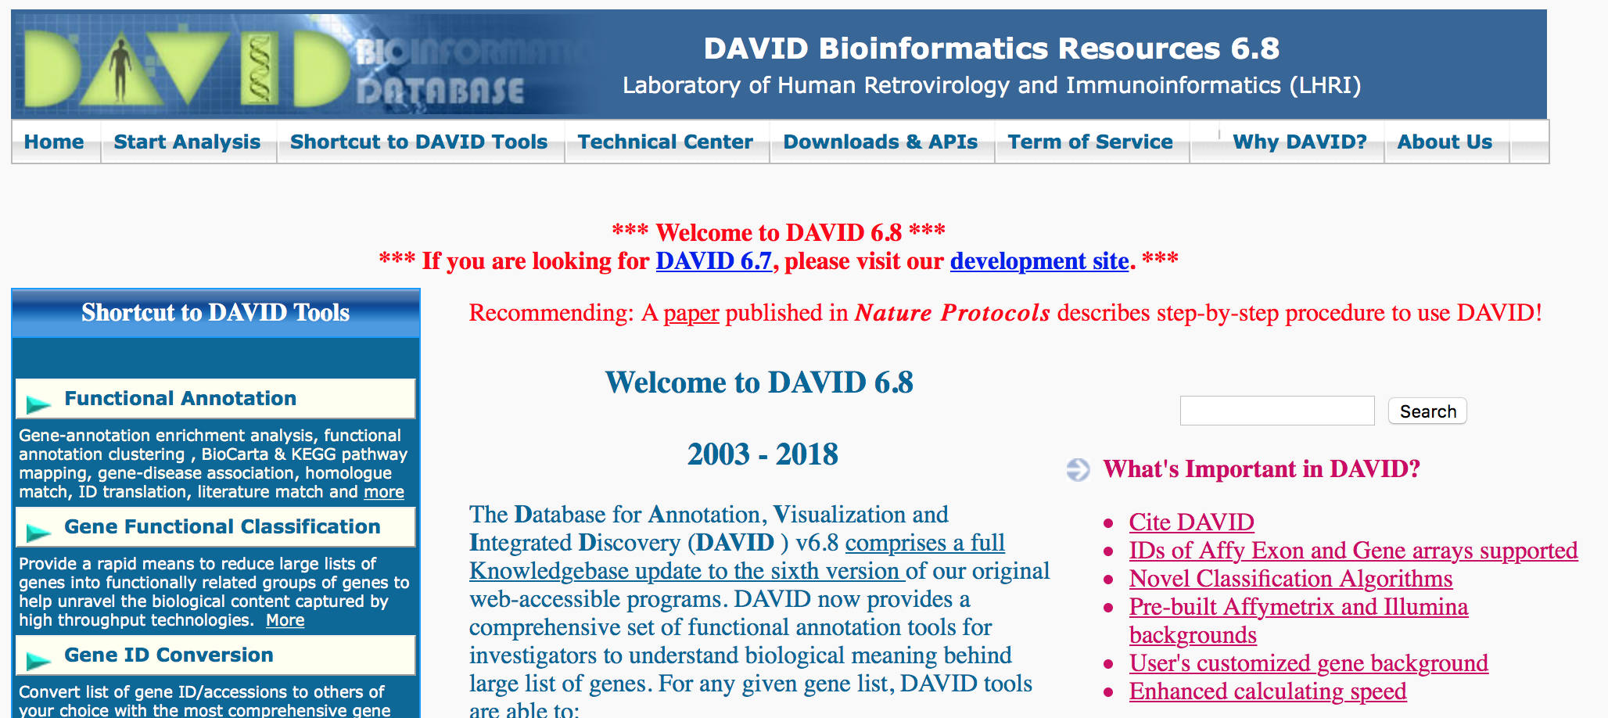
Pathway analysis
Pathway analysis helps to identify novel pathways that may be disease relevant
Skewed towards cancer
Not always informative
Paid vs public

Slide 32
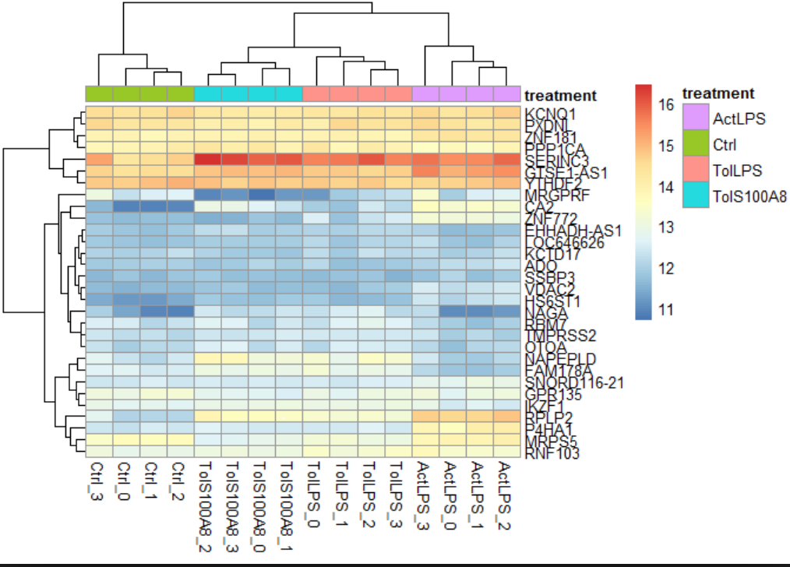
Biological interpretation
The most important part and most difficult
Can be a problem when dealing with a company
Language barrier between biologist and bioinformatician
Visualising data helps overcome this

Slide 33
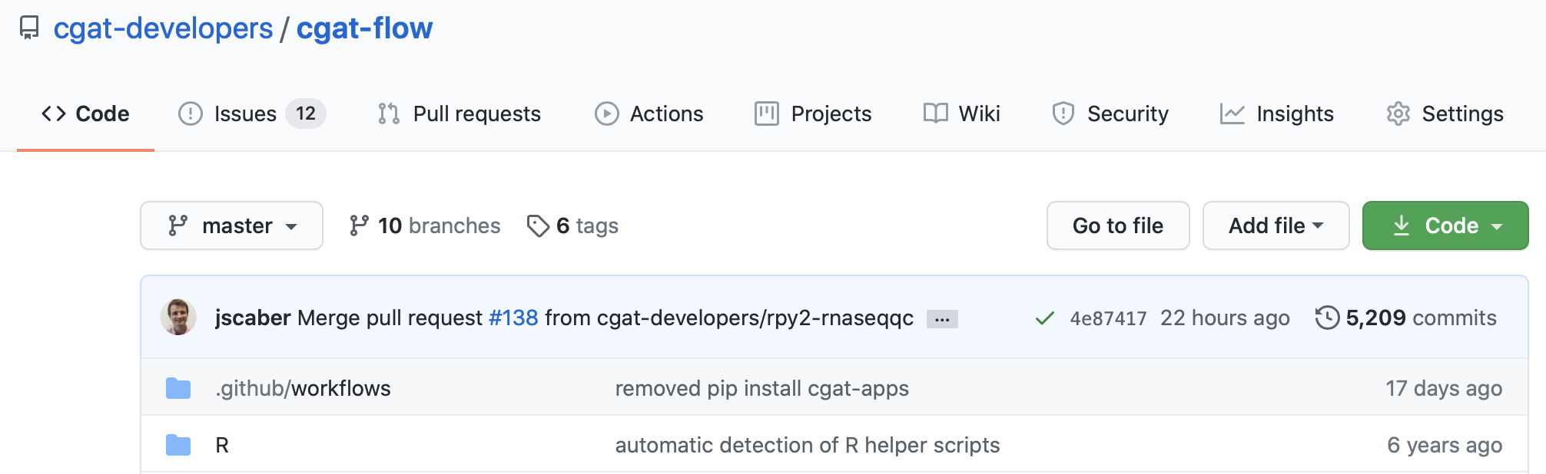
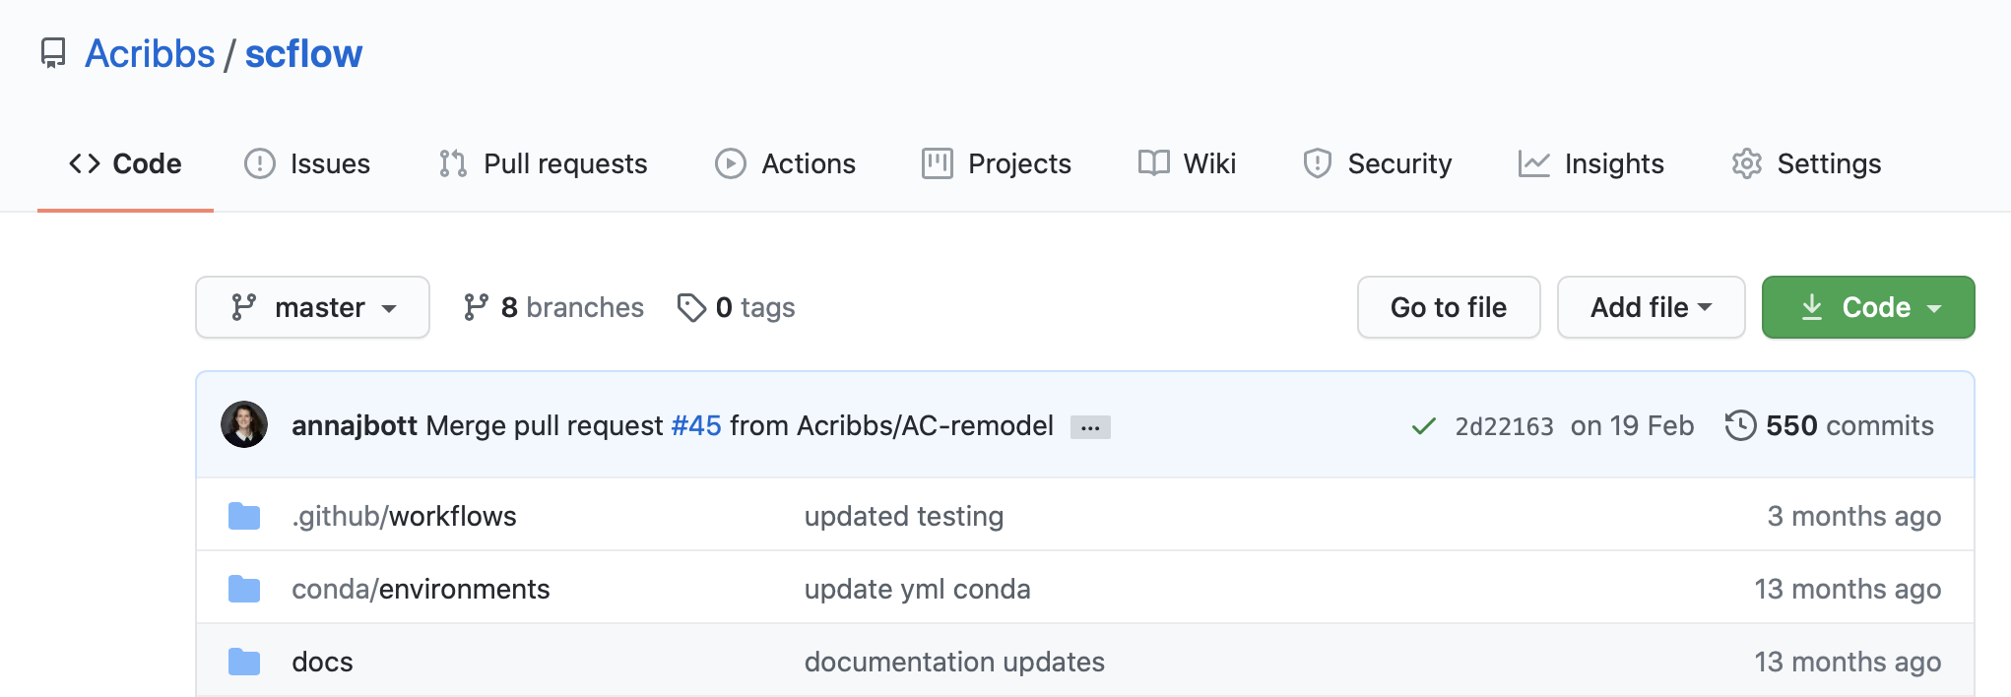
Developing pipelines
To speed up your analysis and make your code reproducible you need to write pipelines
https://github.com/Acribbs/scflow

Slide 34
Further resources

Slide 35
Further resources
Please email me
MOOCS:
Coursera : https://www.coursera.org/learn/bioinformatics-methods-1
Edex: https://www.edx.org/micromasters/bioinformatics
Programming skills:
Codeacademy
EBI Introduction to Next-generation sequencing course - competitive

